Slide 1

Project Plan/Design & Task Distribution
Integrative Project in Computer Science and Mathematics (420-204-RE)
Brick by Brick (CiHao Zhang, Lucas Chauveau, Qian Qian)

Slide 2
Tasks Breakdown, Timeline and Tasks Assignment
01

Slide 3
User Stories - Chow
User Story | Tasks
Arithmetic calculations, allowing the user to perform basic calculations needed for day-to-day computations. | Prepare simple, non-programmable arithmetic calculations excluding trig. Design algorithms for Deriving and Integrating functions. Implement bound calculations for derivates & integrals.
Enhancing user experience through input formatting | Interpreting & Handling calculations from MathJSON. Variable support for calculations. Implement functional, interactive buttons for the calculator. Design trigonometric expressions to work under MathJSON.
Aesthetically pleasing outputs & proper formatting | Create dynamic output boxes for arithmetic calculations. Scientific notation support for result of the calculation.
Persistency through sessions | Handle Import/Export for FileIO.

Slide 4
Tasks & Timeline - Chow
Interpreting & Handling calculations from MathJSON
Part 1
Prepare simple, non-programmable arithmetic calculations, excluding trig
Part 1
Design algorithms for Deriving and Integrating functions
Part 1
Implement bound calculations for derivates & integrals
Part 1
Design trigonometric expressions to work under MathJSON
Part 2
Scientific notation support for result of the calculation
Part 2
Variable support for calculations
Part 2
Implement functional, interactive buttons for the calculator
Part 3
Create dynamic output boxes for arithmetic calculations
Part 3
Handle Import/Export for FileIO
Part 3

Slide 5
User Stories - Lucas
User Story | Tasks
Clean and Pleasant UI | Everything FXML and CSS related
Persistency between sessions | Save and Load system for user settings
Seamless experience | Embedding and testing of CortexJS

Slide 6
Tasks & Timeline - Lucas
FXML and Scene Workflow
Arithmetic Calculator FXML
Graphing Calculator FXML
Settings Controller and FXML
Programming Mode FXML
Part 1
Part 1
Part 1
Part 1
Part 2
Backend to enable CortexJS testing
Embedding of the CortexJS library with UI
CSS reusable classes and general styles
Populate Menu bar with children and button functions
Save/Load in JSON Format for Settings
Part 2
Part 2
Part 3
Part 3
Part 3

Slide 7
User Stories - Qian
User Story | Tasks
Programming Mode that allows the calculator to do repetitively the same actions over a set of data. | Implementation of the CalcLox Language Interpreter. Implementation of the conversion of the visual-computational expression for formulas. Integration of the programming mode and other modes of the calculator.
Library of functions for programs can be useful to have commonly used function stored and share for reuse. | Implementation of the library support for CalcLox. Implementation of a official library of functions.
Numeric (unit conversion, numeral system conversion) and Symbolic (formula simplifier) can be useful. | Implementation of the tools.

Slide 8
Tasks & Timeline - Qian
Token implementation for CalcLox.
Part 1
Parser and Scanner implementation for CalcLox Interpreter.
Part 1
Java-logic-independent
functionalities for CalcLox.
Part 1
Java-logic-dependent
functionalities for CalcLox.
Part 1/2
LaTeX-MathJSON
Expression
Converter
Part 2
Programming Mode Integration with other parts.
Part 2
Library Support for CalcLox.
Part 2
Tools: Numeric Conversion Tools
Part 3
Tools: Symbolic Operation Tools
Part 3
Official Library of functions.
Part 3

Slide 9
02
Class Diagram

Slide 10
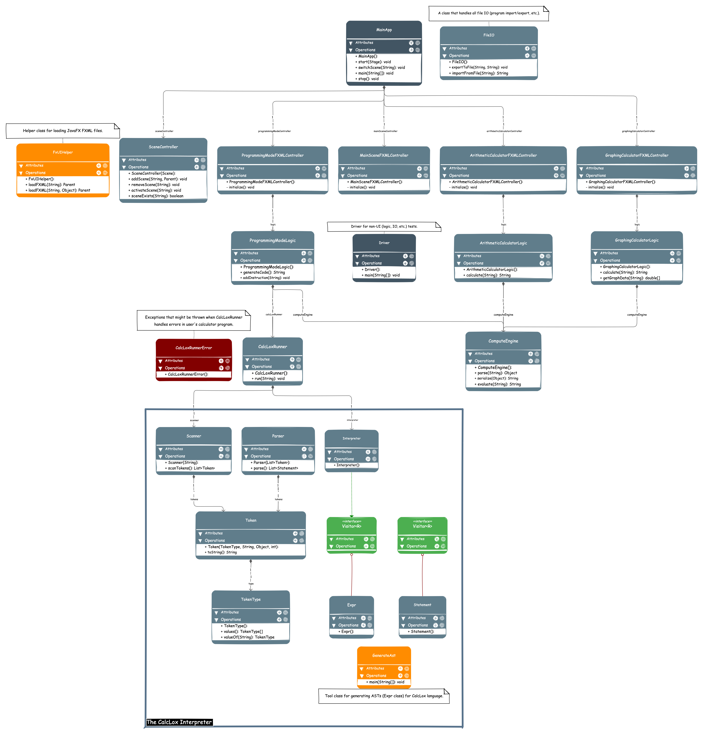

Slide 13
Input/Output Diagram
03

Slide 14
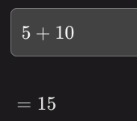
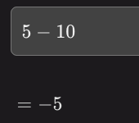
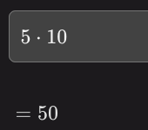
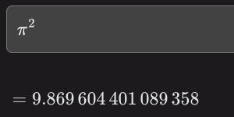
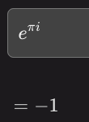
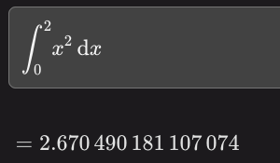
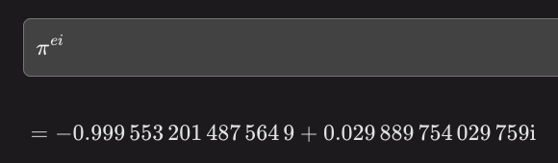
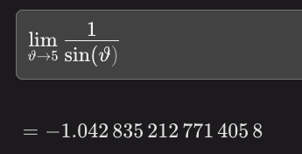
Arithmetic Calculation: LaTeX Formula Input, Numeric Output
more complicated calculations like Functions, Limit, Derivative, Integral, and Complex Numbers are supported

Slide 15
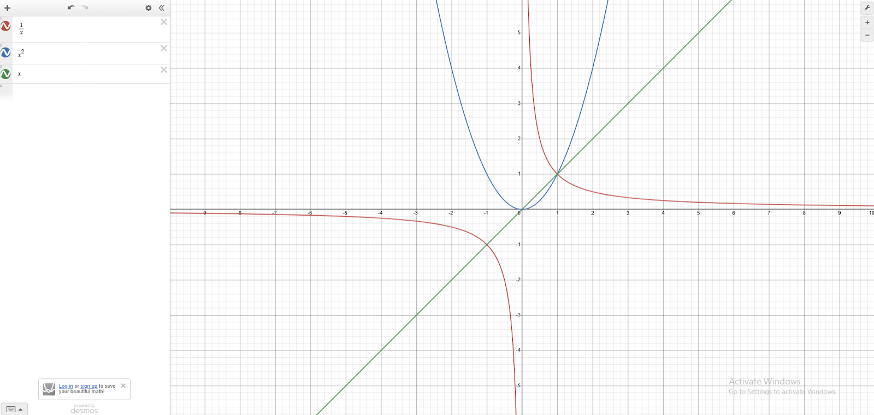
Graphing Calculator: LaTeX Formula Input, Graphical Output

Slide 16
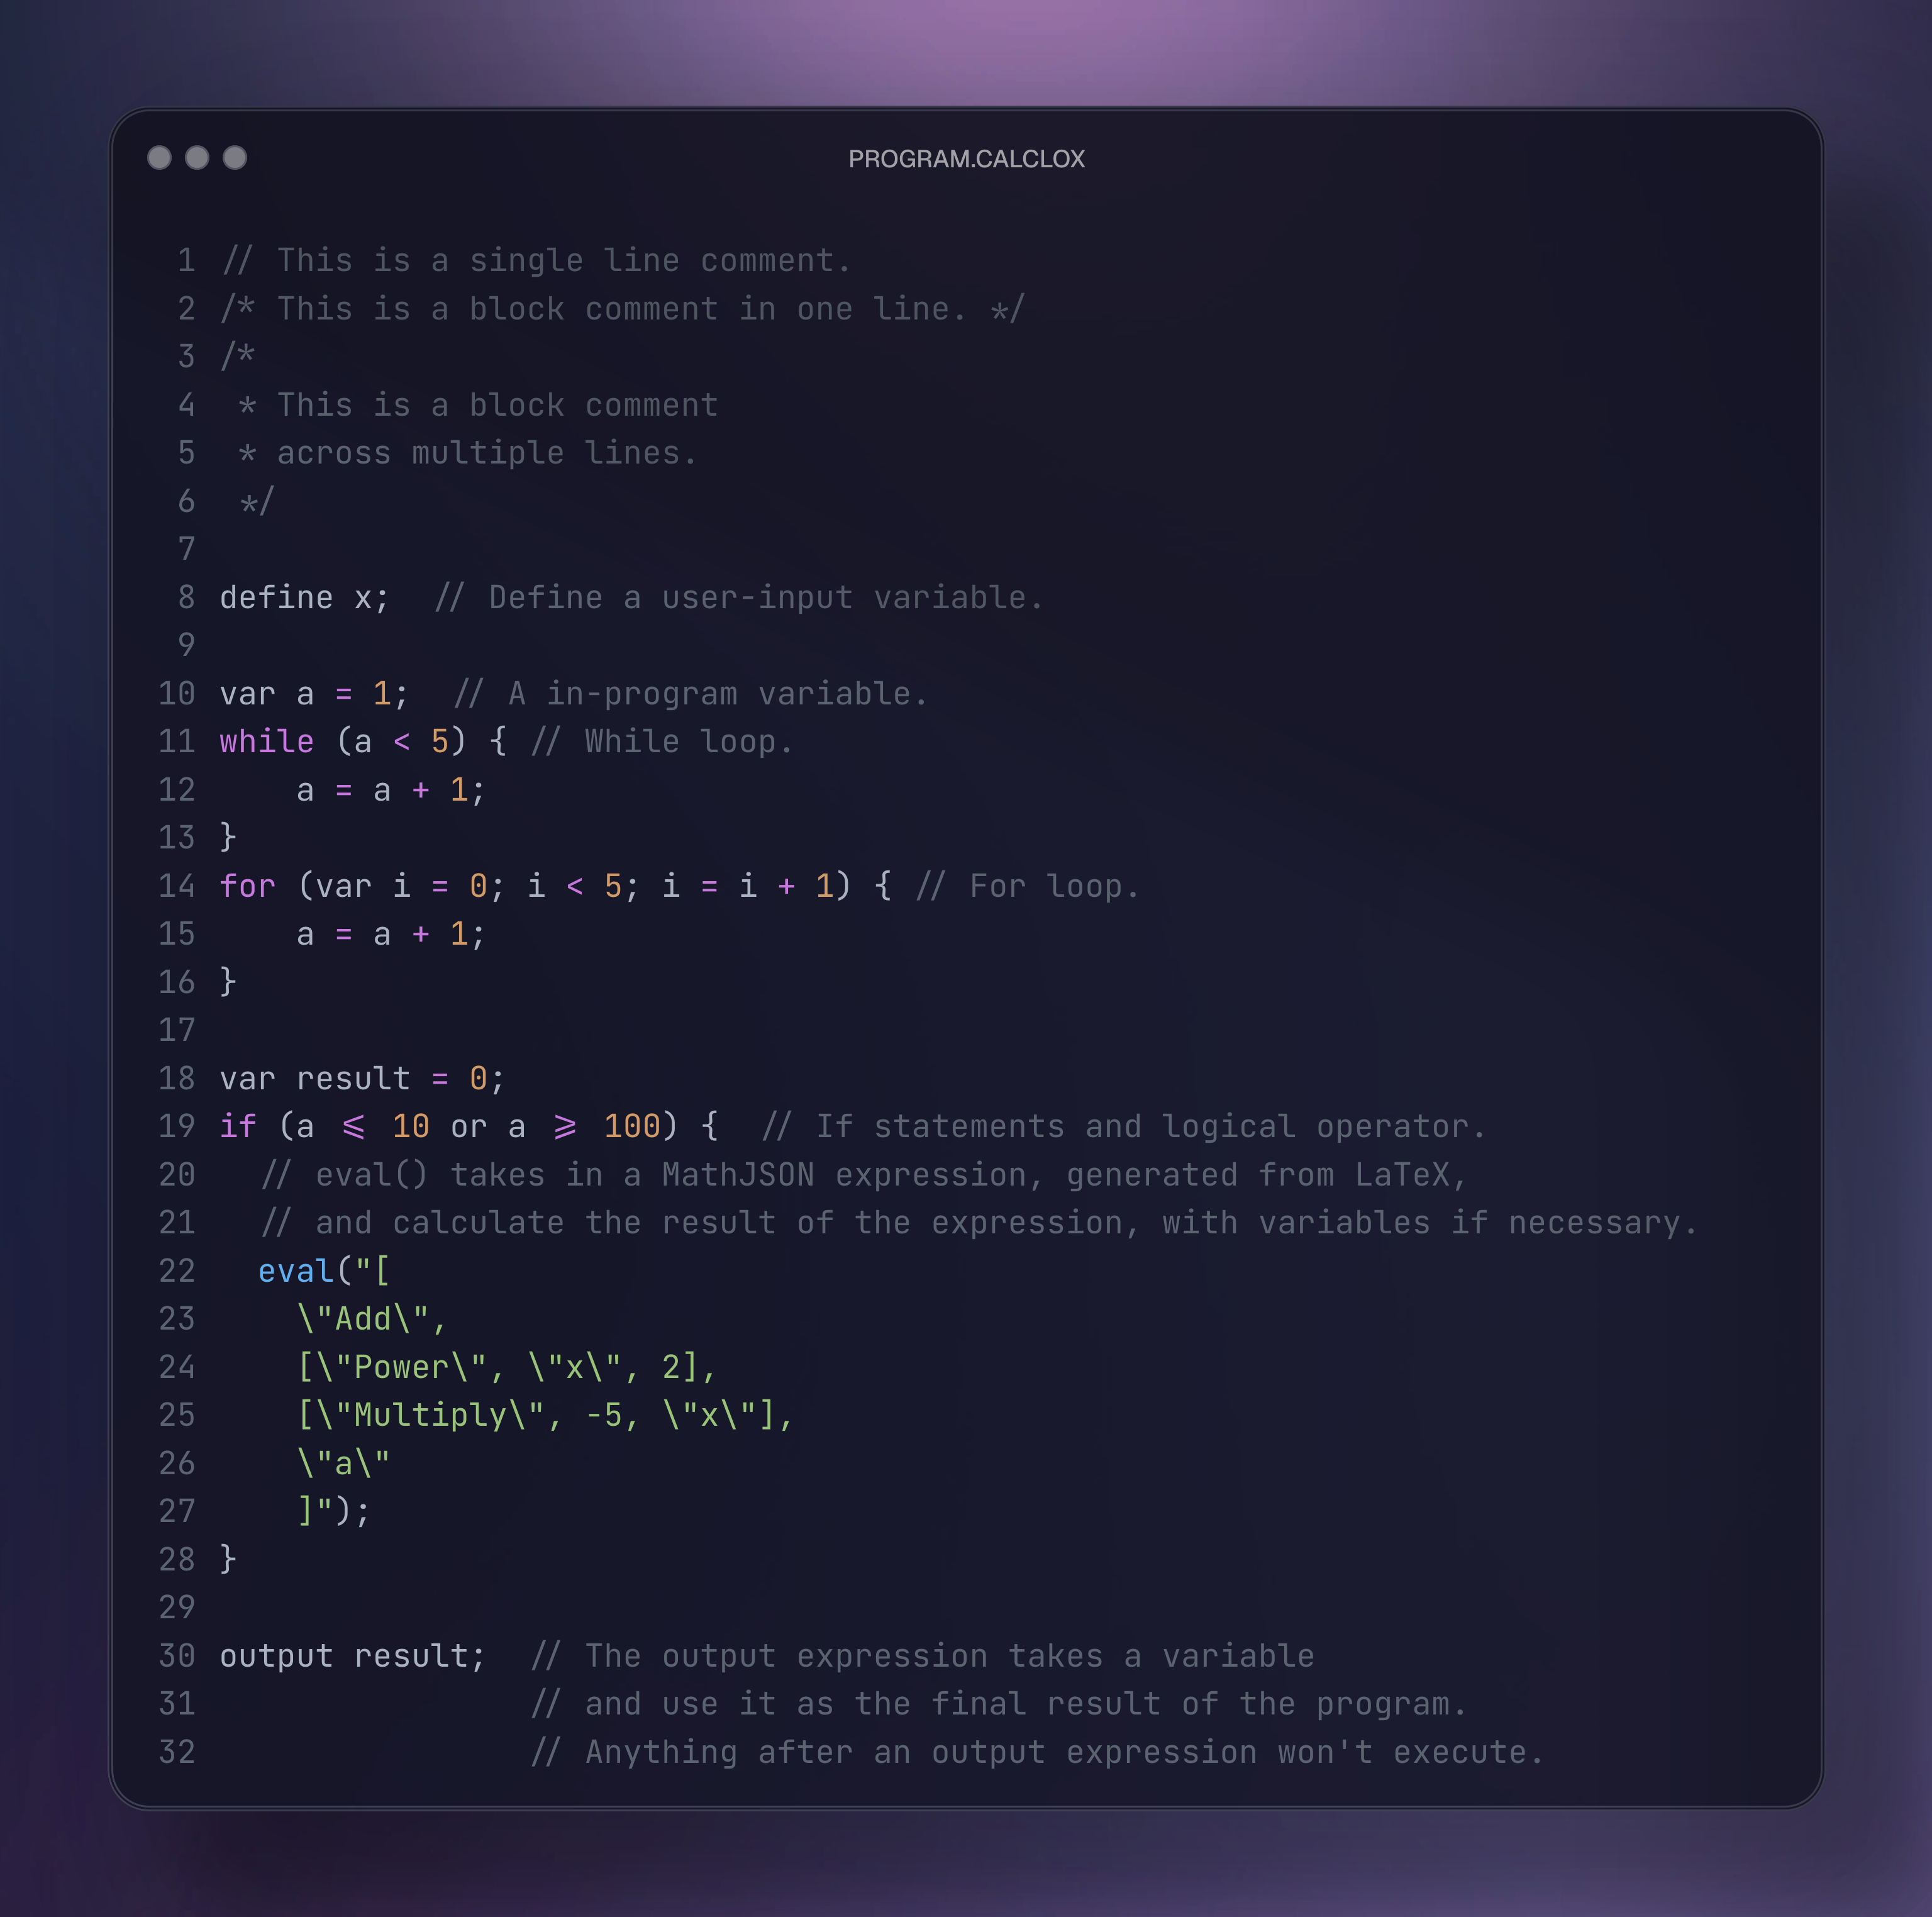
USER INPUT | OUTPUT
x = 5 | 9
x = 15 | 0
x = 100 | 0
x = 150 | 21 759
Programmable Feature:
Code & User Variable Input, Numeric or Graphical Output

Slide 17
04
Wireframes and Mockups

Slide 18
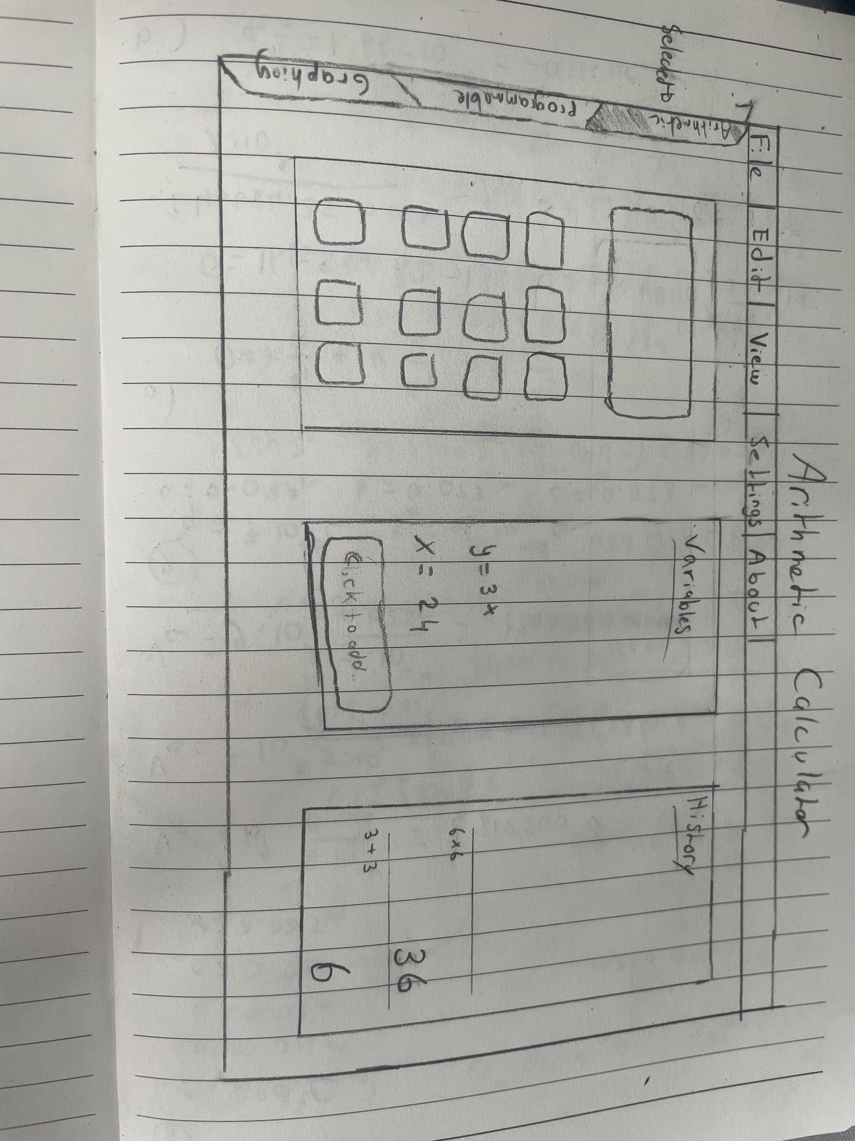
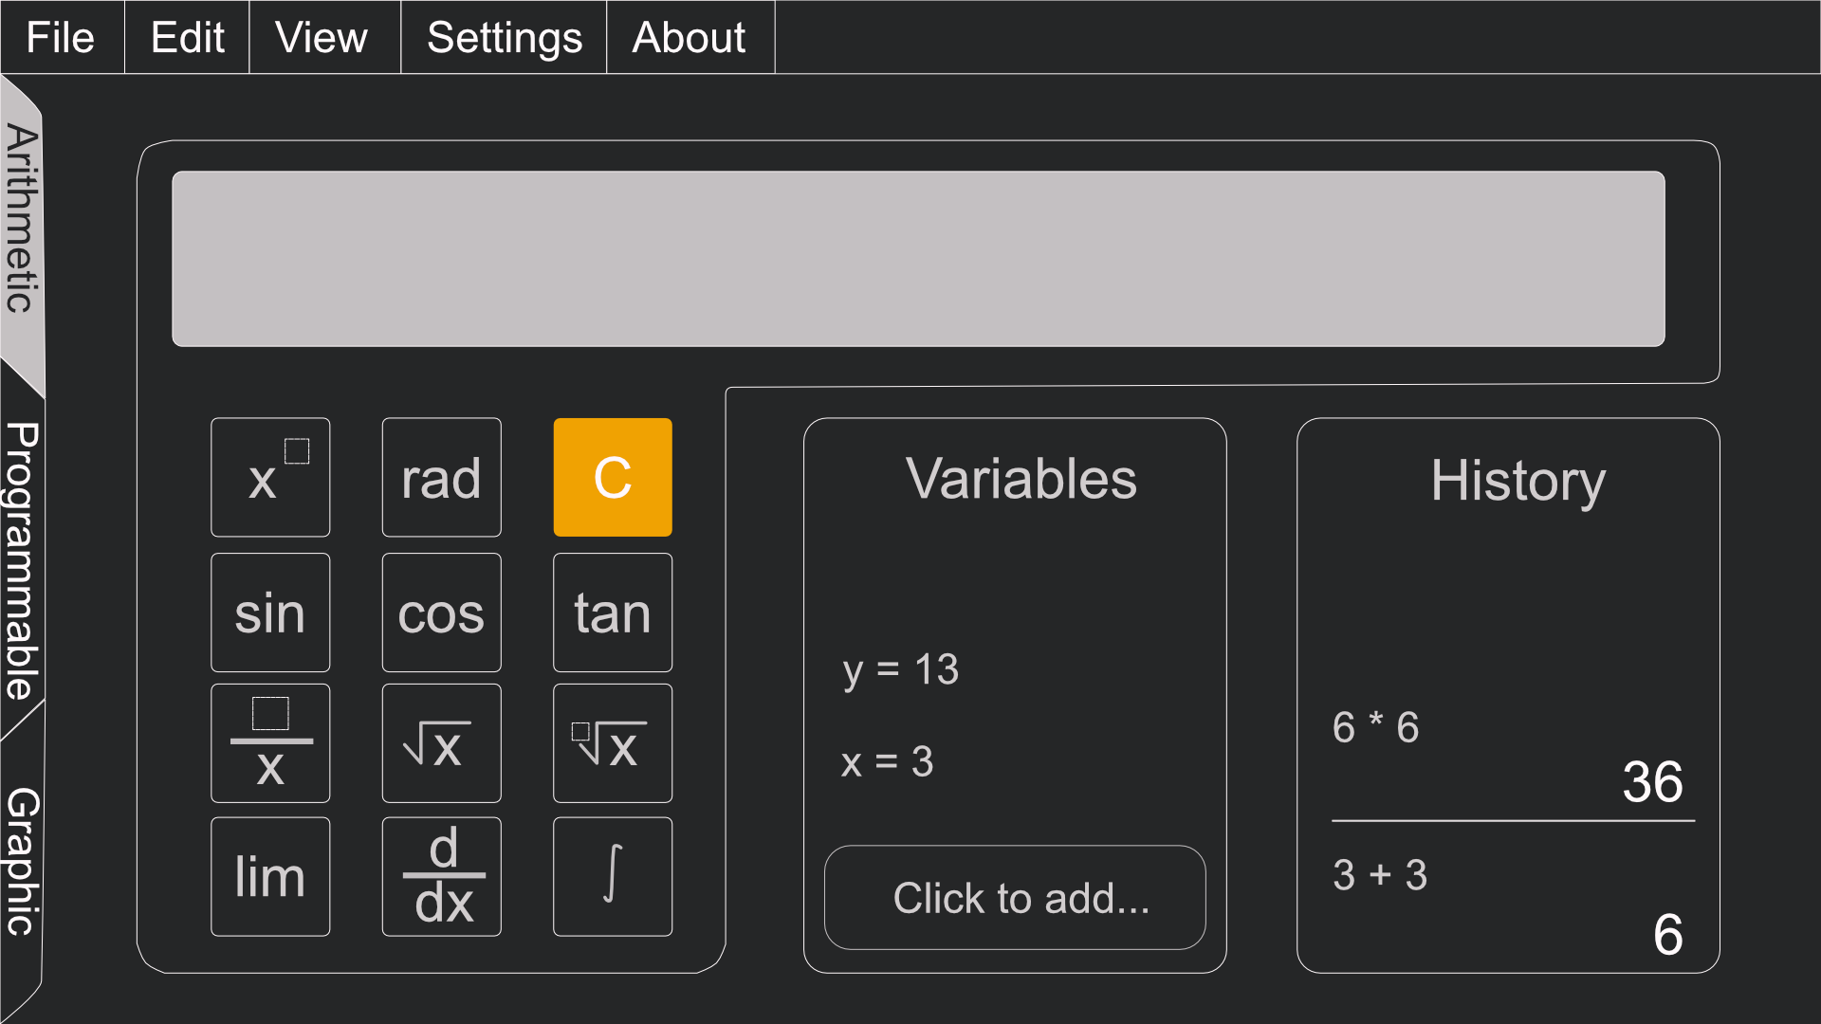
Arithmetic Calculator Wireframe and Mockup

Slide 19
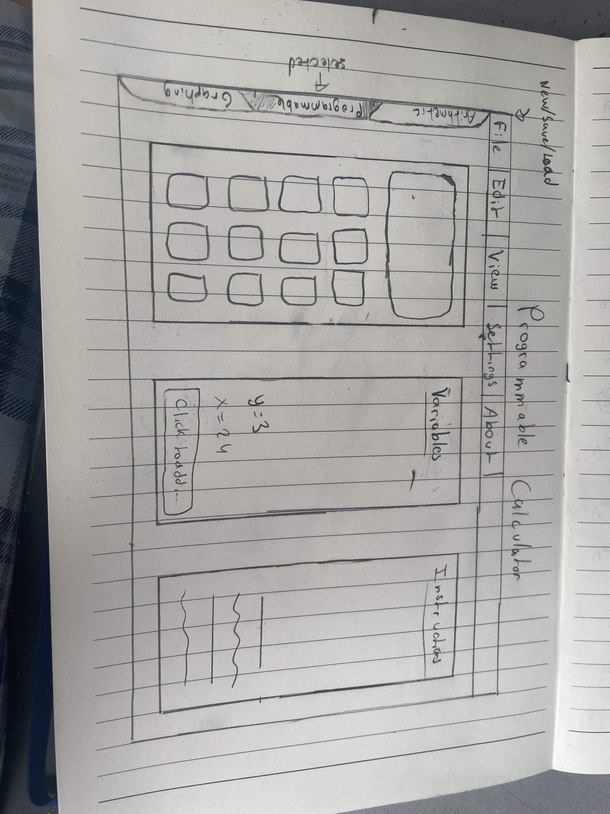
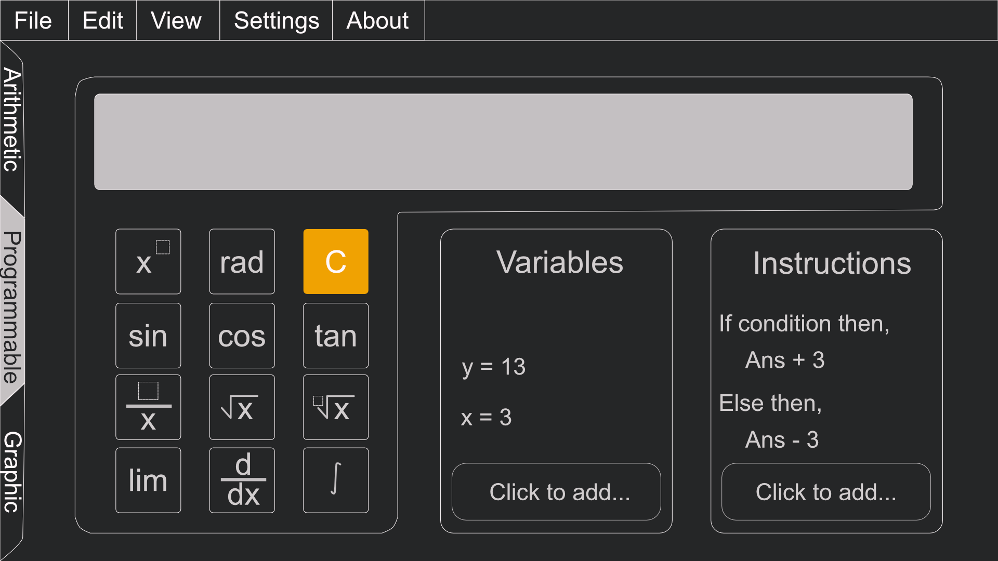
Programming Mode Wireframe and Mockup

Slide 20
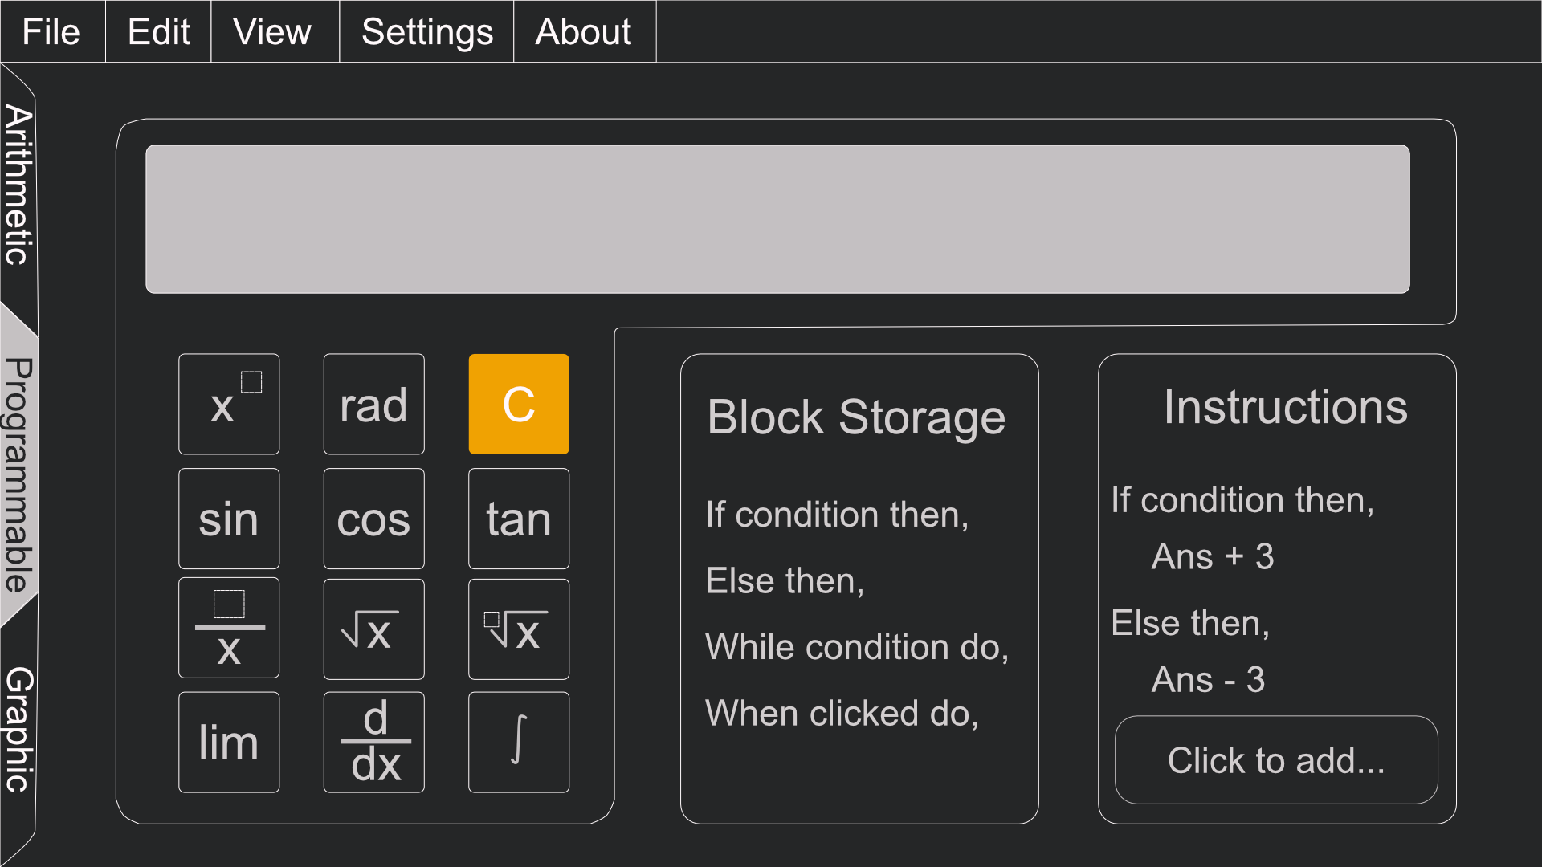
Programming Mode Pt.2

Slide 21
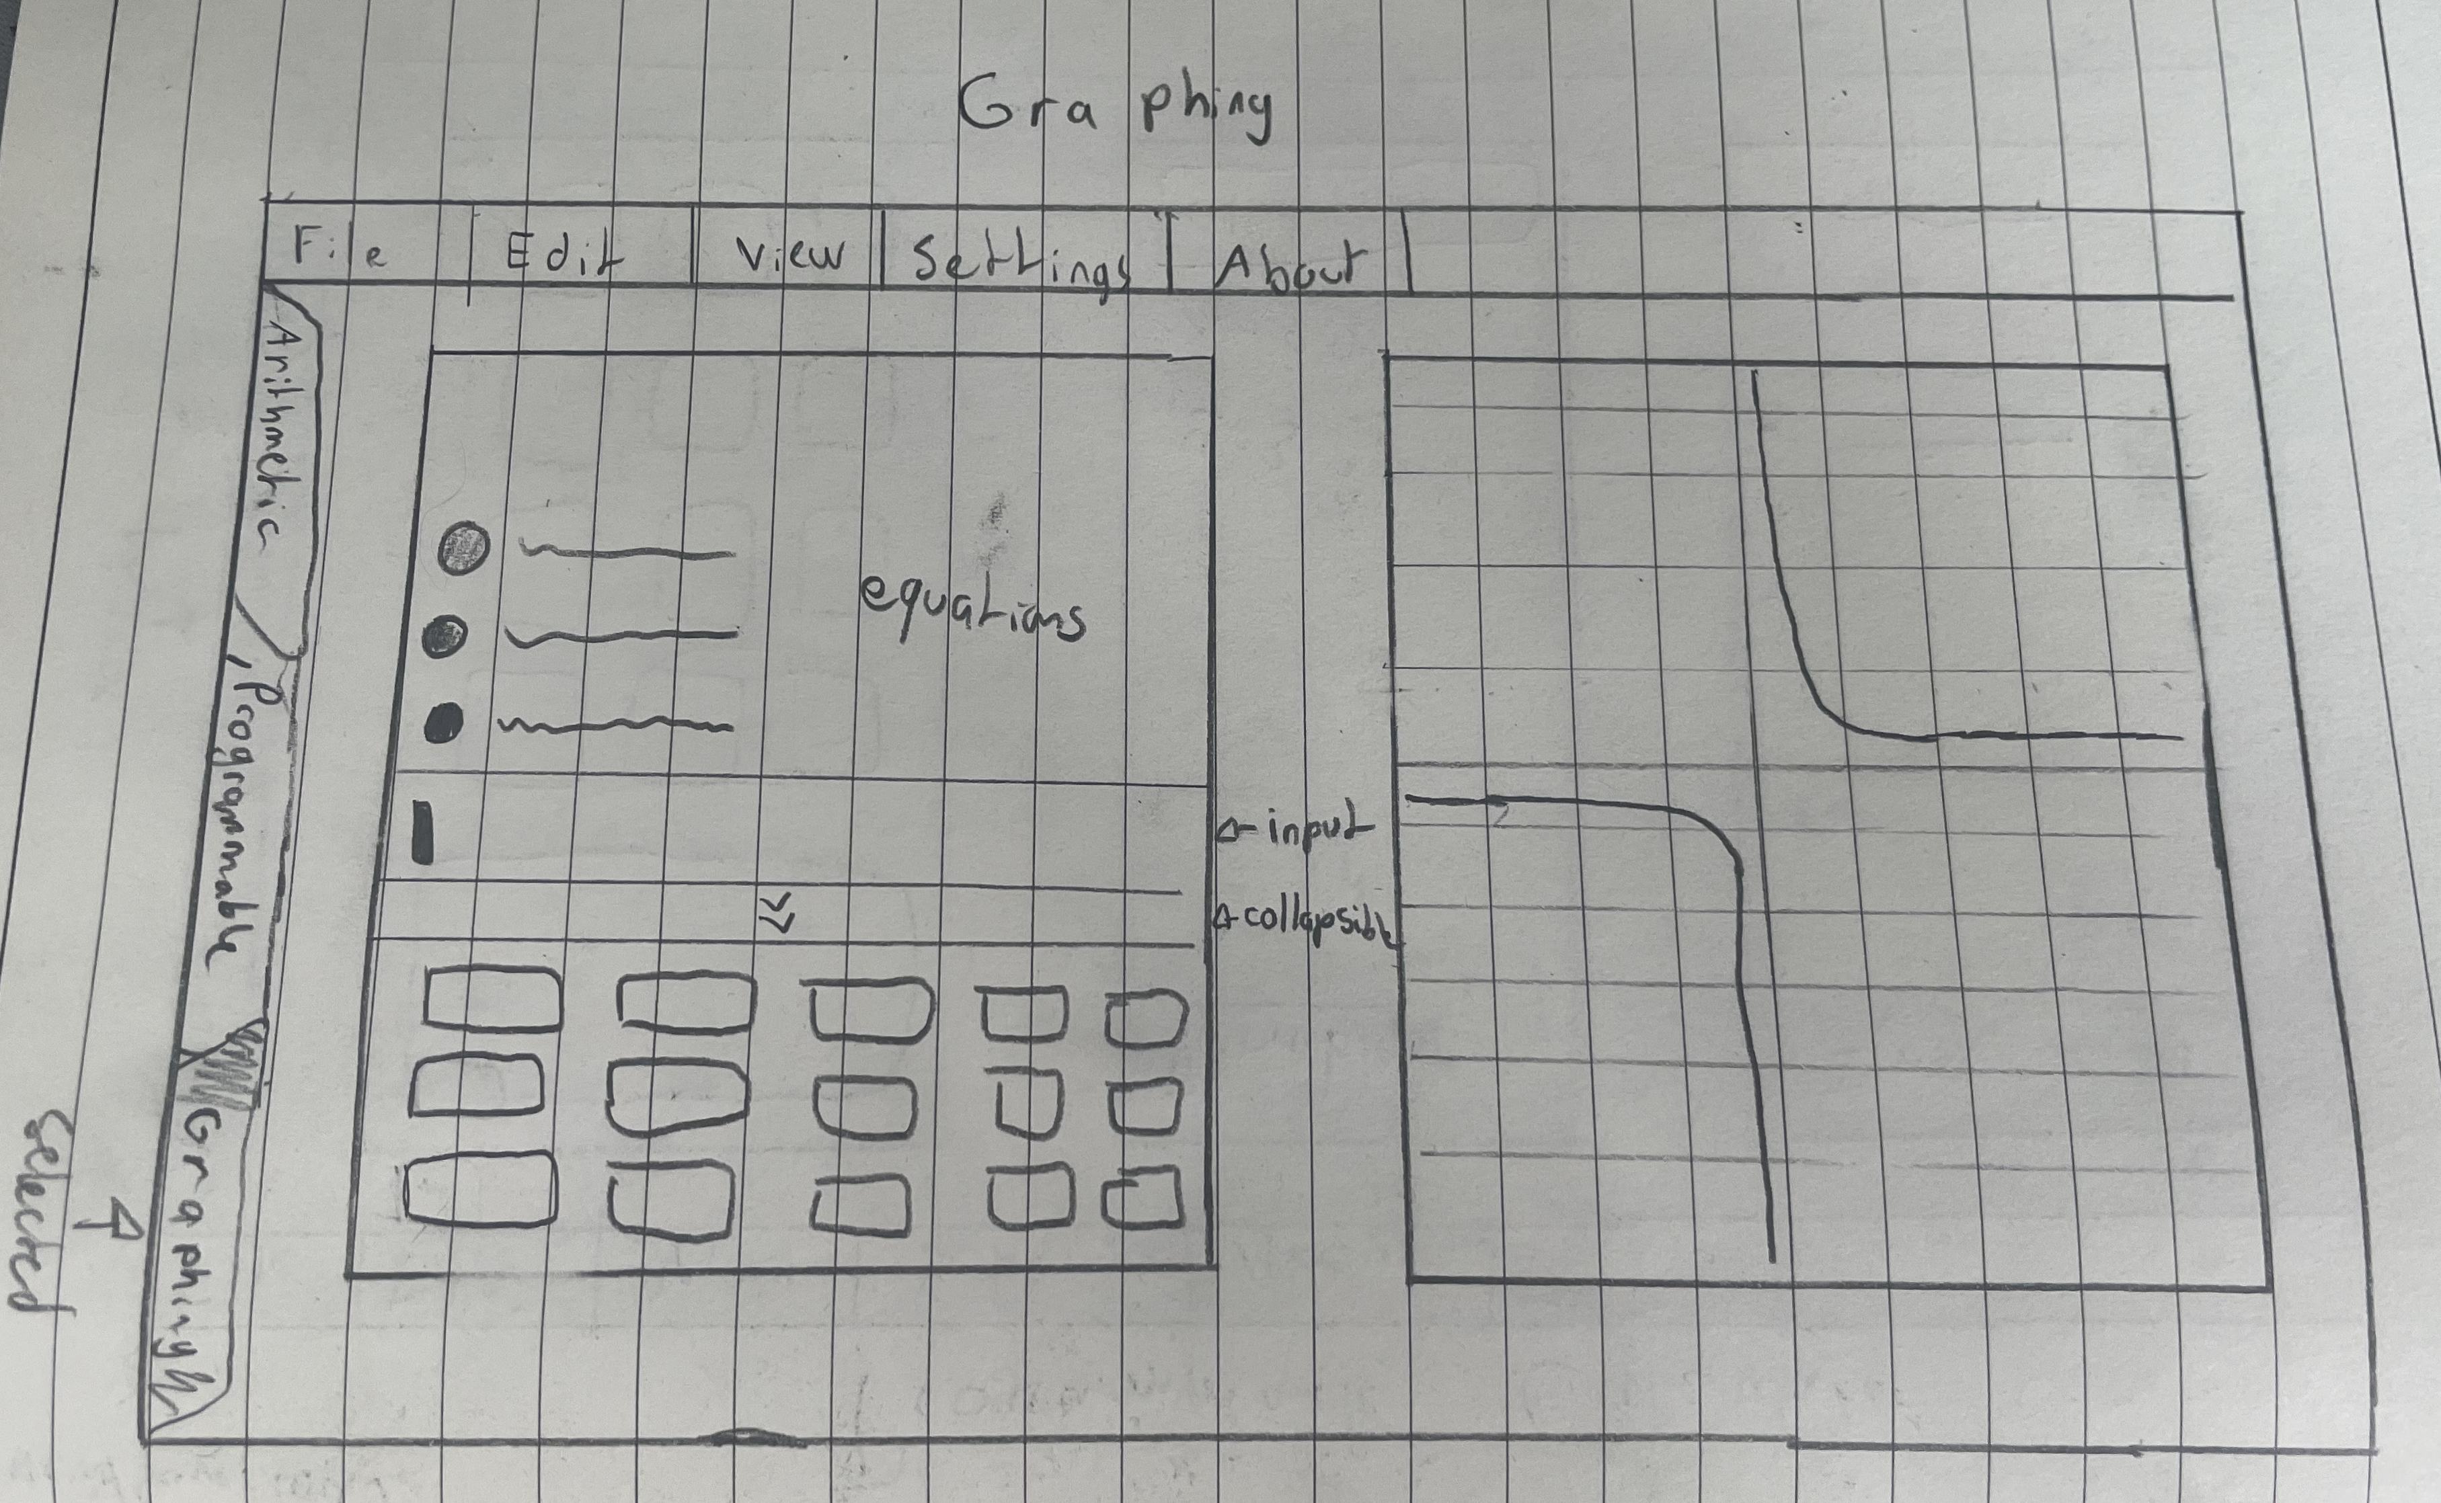
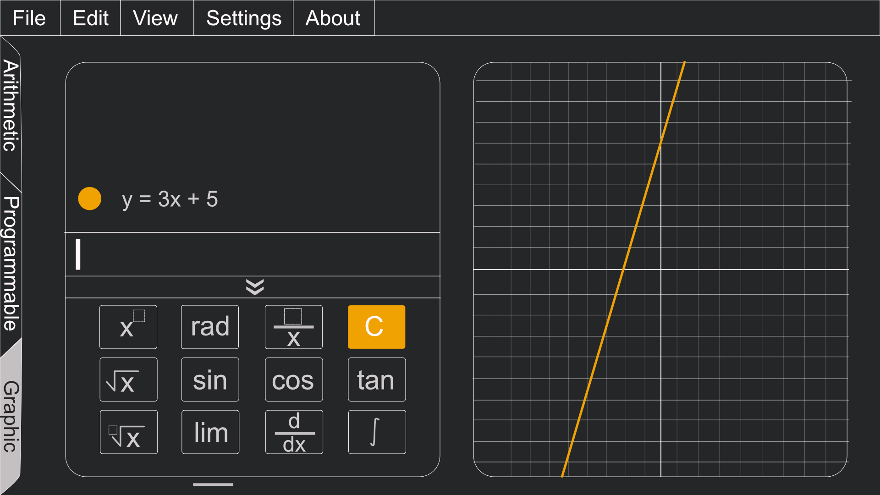
Graphing Calculator Wireframe and Mockup

Slide 22
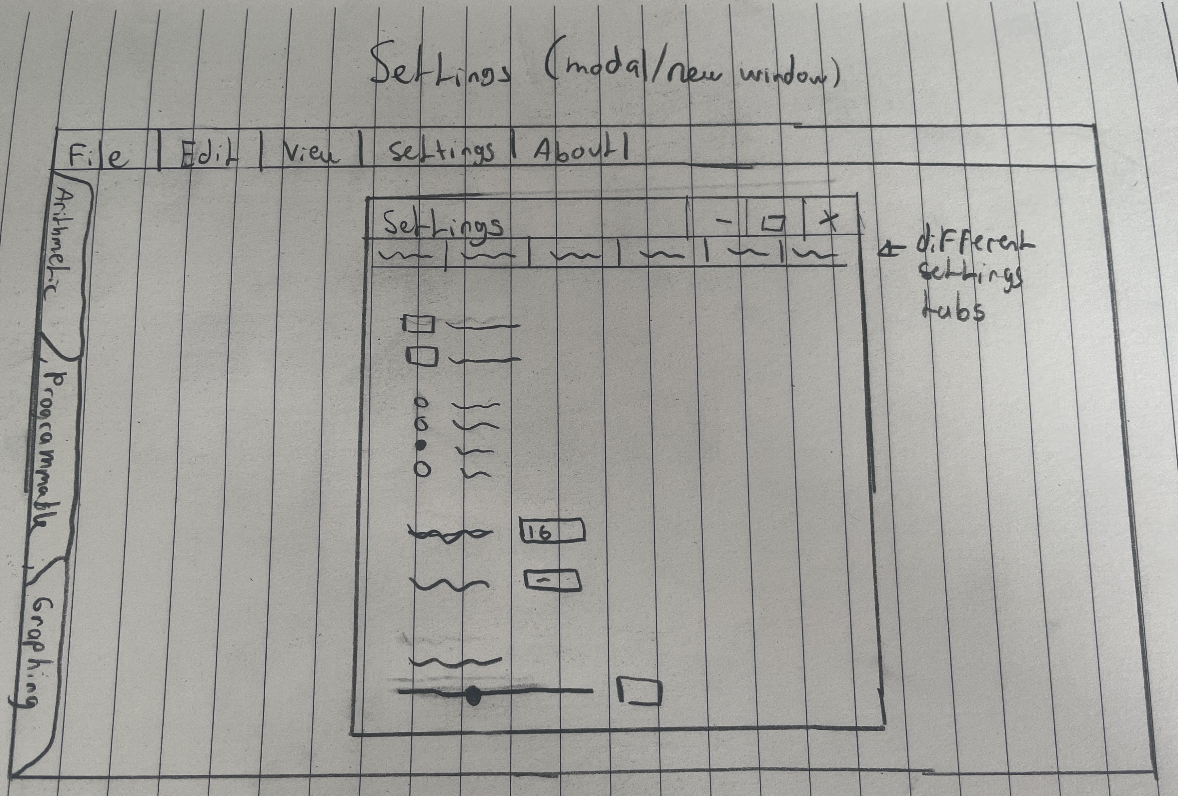
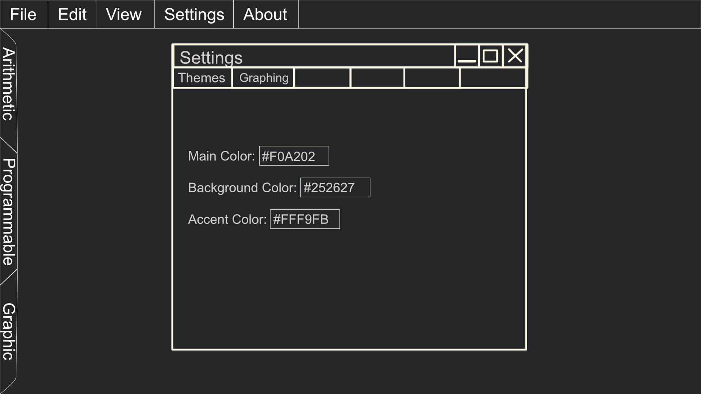
Settings Wireframe and Mockup

Slide 23
Sprint Report
05

Slide 24
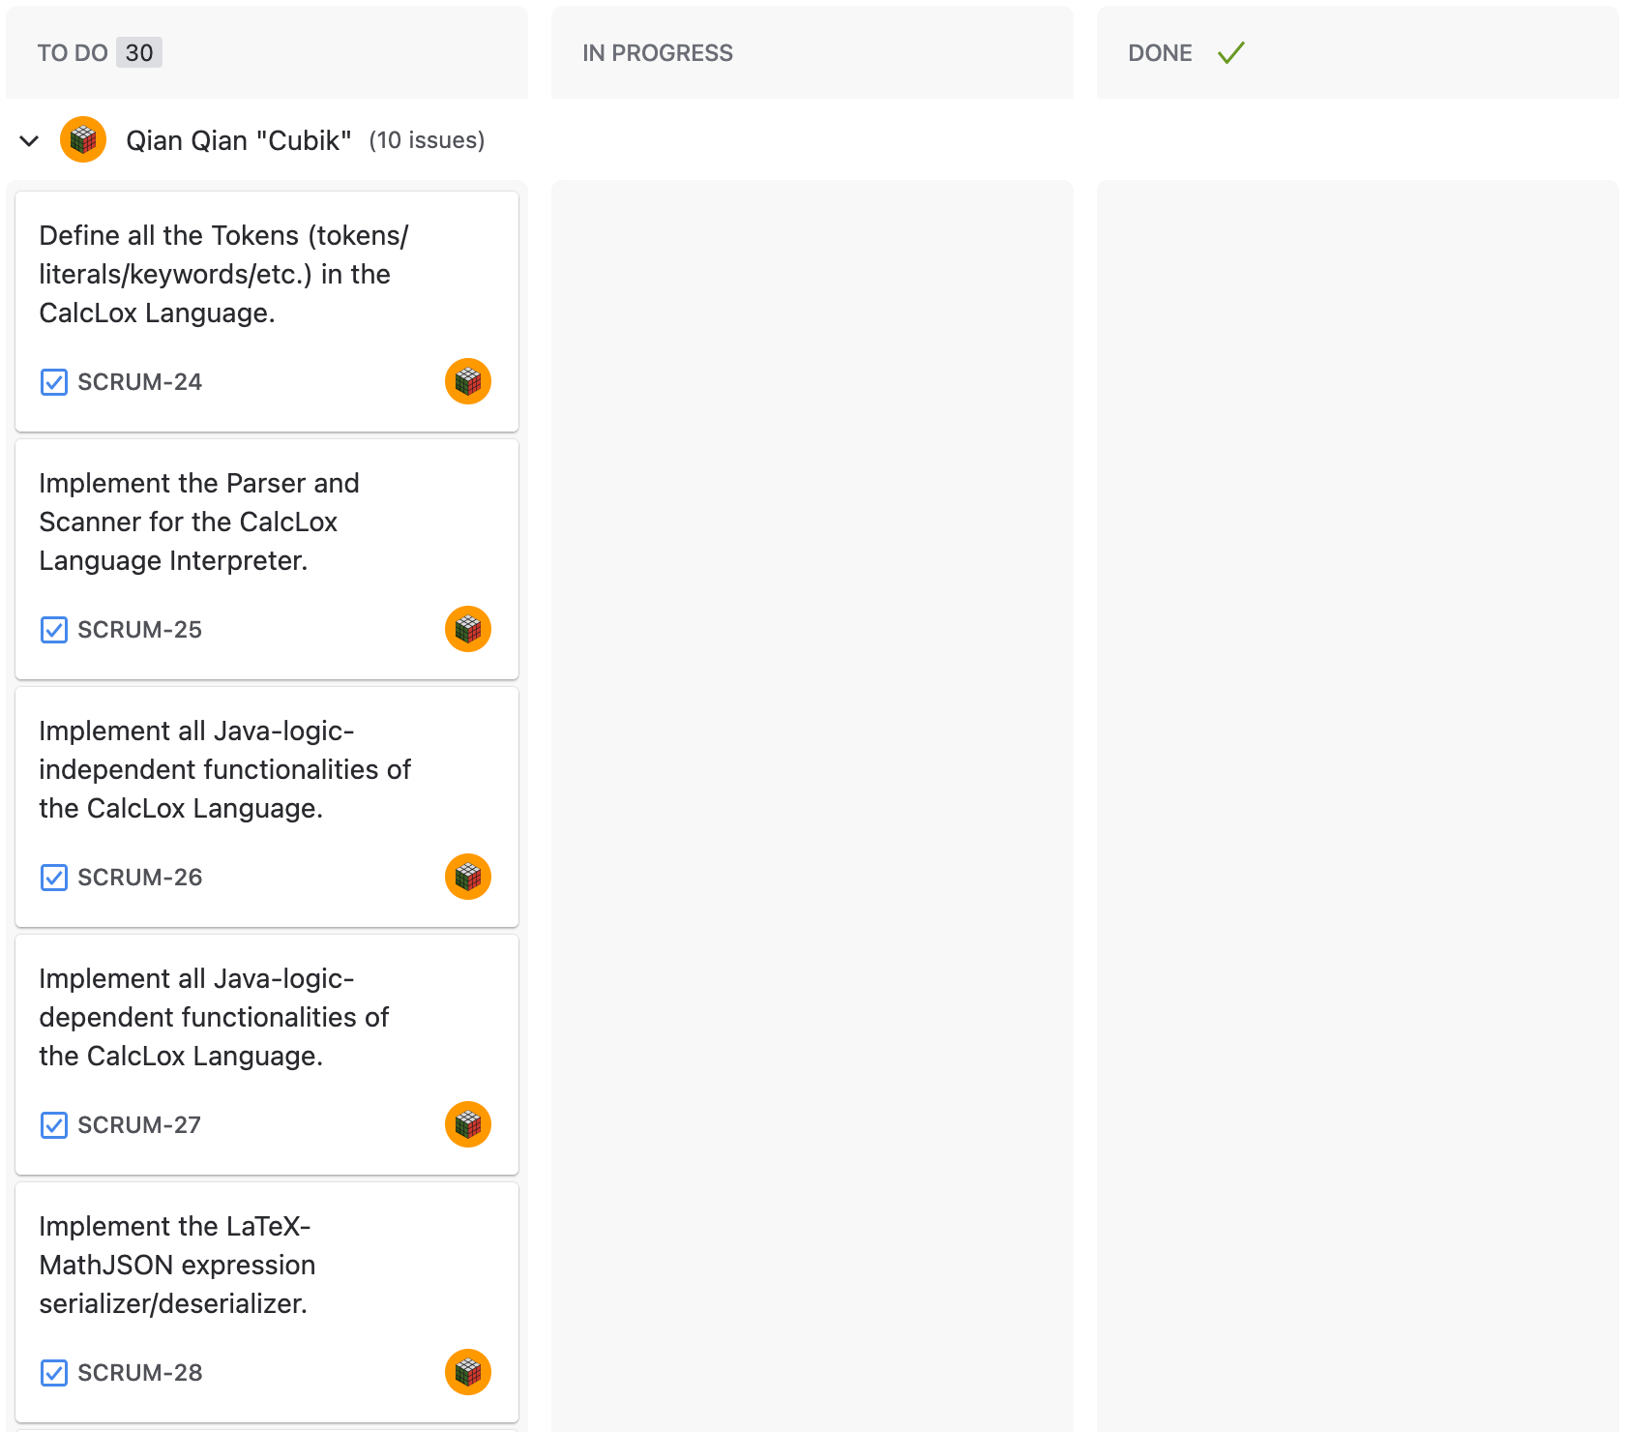
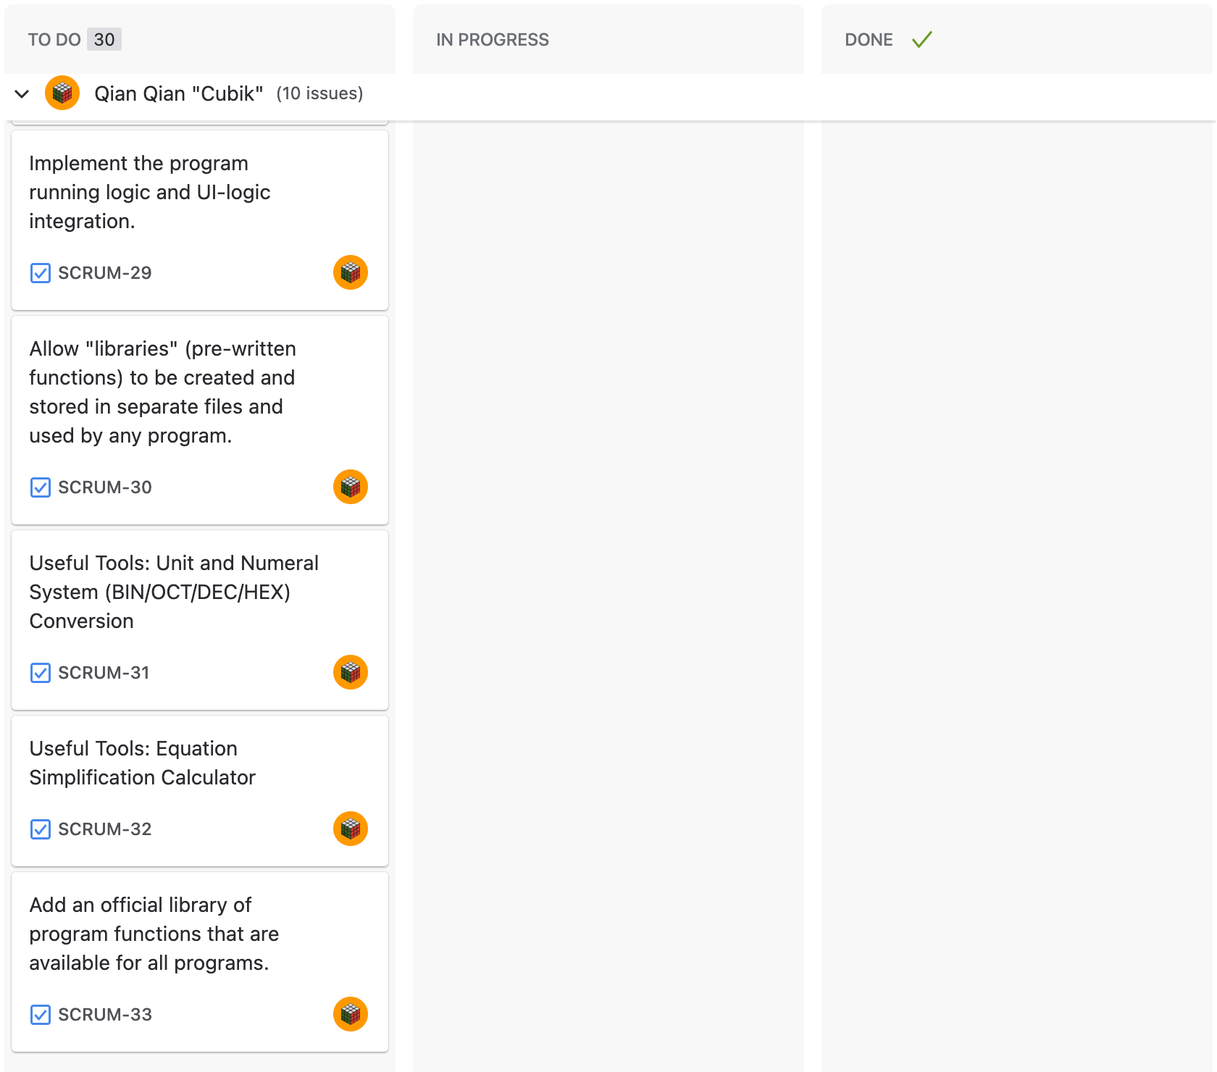

Slide 25
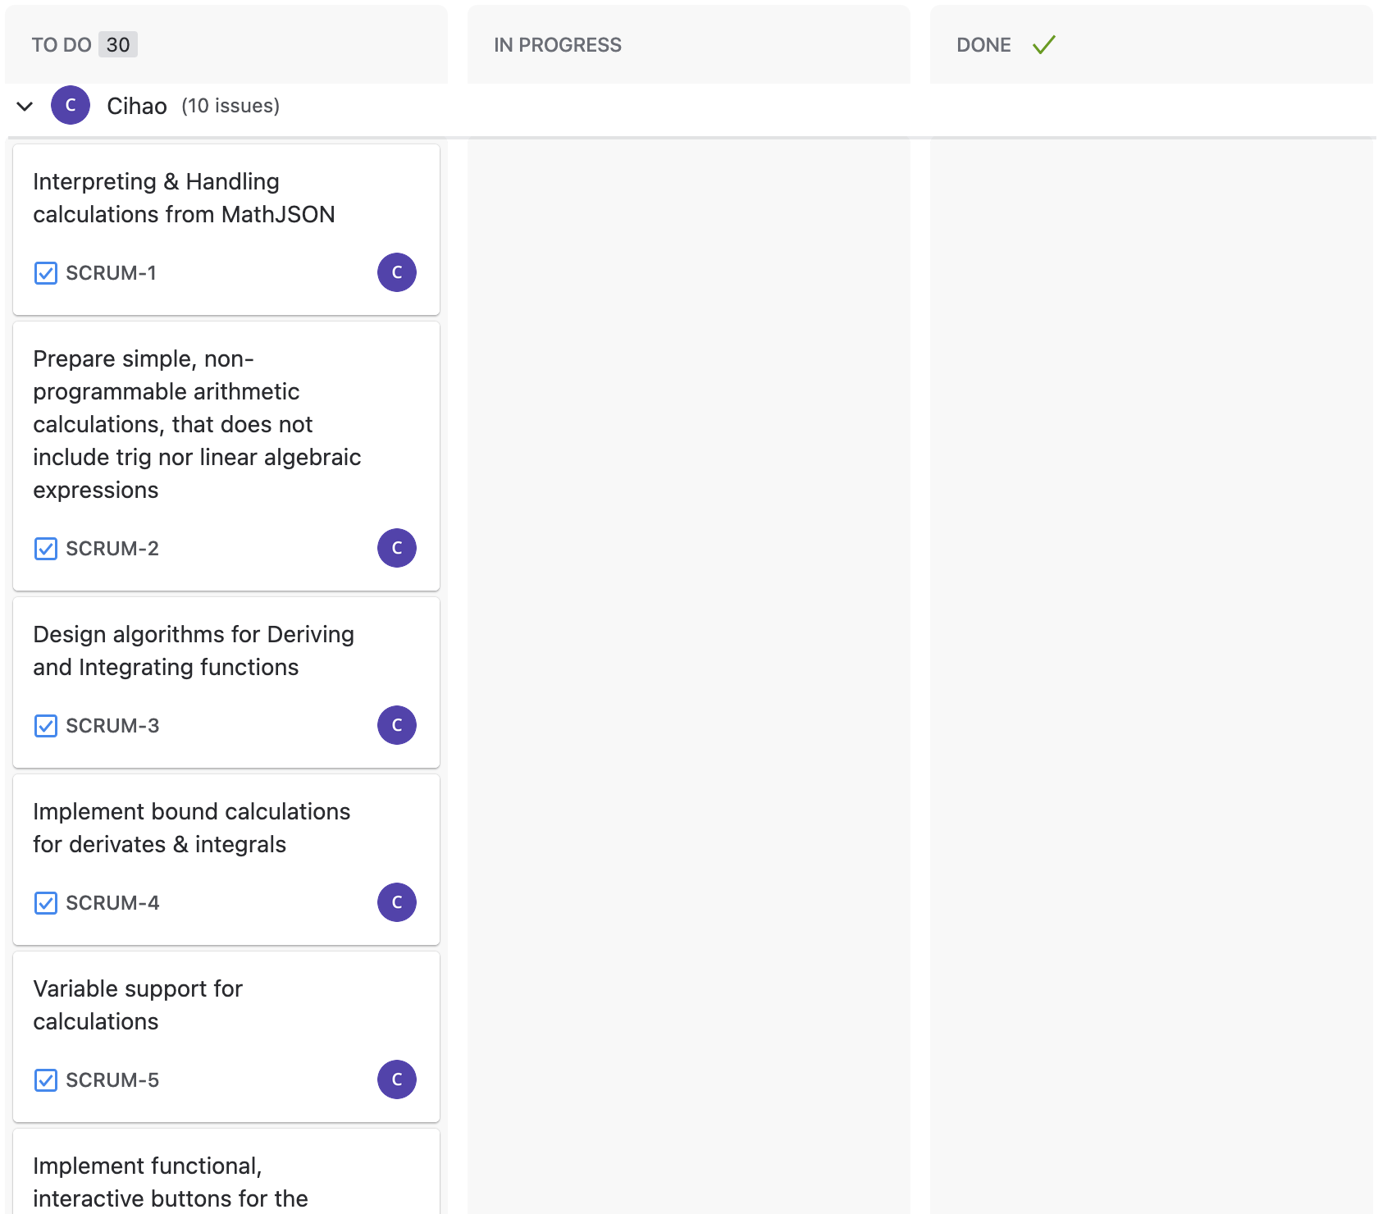
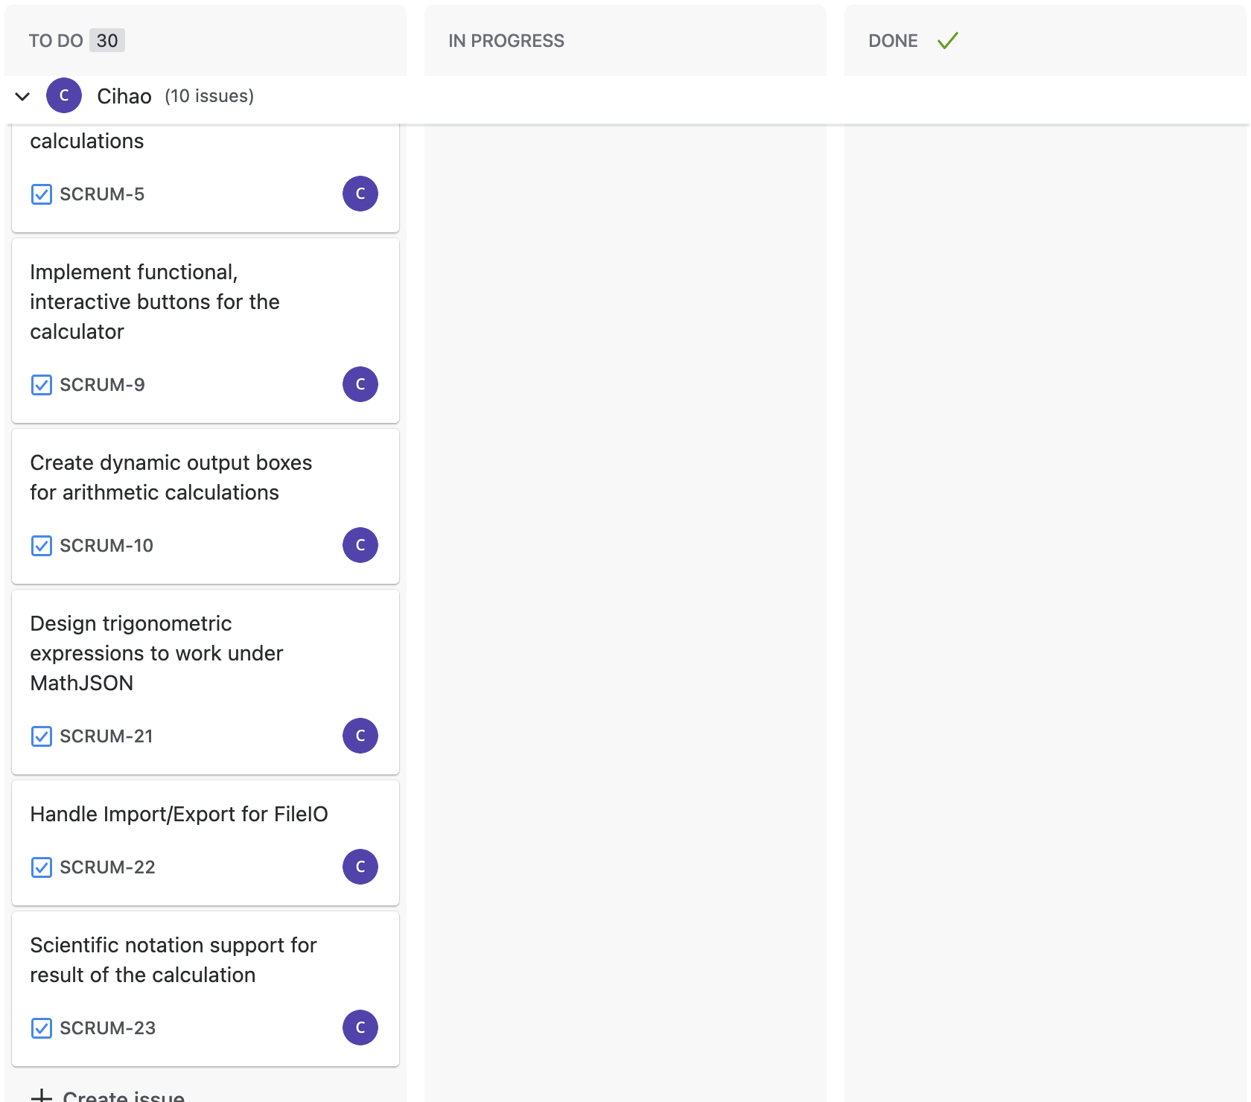

Slide 26
